Slide 1

Stat 6509
Final Project
Red Wine Quality
Chi Nguyen, Simona Nallon, Mulati Patiguli

Slide 2
Table of Contents
Problem Set Up
Exploratory Analysis
Model Selection
Final Model Results
Diagnostics
Conclusion

Slide 3
Problem Set Up
Data source
Red wine dataset we used for our project is from UCI Machine Learning Repository (http://archive.ics.uci.edu/ml/datasets/Wine+Quality)
Data Description
Experts conducted physicochemical tests (e.g. pH values and acidity... ) on the red wine samples from the north of Portugal and made an evaluation based on the median of 3 wine experts according to their sensory levels and each expert graded the wine quality between 0 (very bad) and 10 (very excellent).
Research Objective
To develop a linear regression model showing the relationship between the quality of wine and various attributes.
Notes:
Fatime
Data Collection/Source
Data Description
Research Question

Slide 4
Variables
Response Variable
Wine Quality
Predictor Variables
fixed acidity
volatile acidity
citric acid
residual sugar
chlorides
free sulfur dioxide
total sulfur dioxide
Density
pH
sulphates
alcohol
fixed acidity | volatile acidity | citric acid | residual sugar | chlorides | free sulfur dioxide | total sulfur dioxide | density | pH | sulphates | alcohol | quality
6.5 | 0.9 | 0 | 1.6 | 0.052 | 9 | 17 | 0.99467 | 3.5 | 0.63 | 10.9 | 6
9.1 | 0.22 | 0.24 | 2.1 | 0.078 | 1 | 28 | 0.999 | 3.41 | 0.87 | 10.3 | 6
6.9 | 0.52 | 0.25 | 2.6 | 0.081 | 10 | 37 | 0.99685 | 3.46 | 0.5 | 11 | 5
7.3 | 0.59 | 0.26 | 2 | 0.08 | 17 | 104 | 0.99584 | 3.28 | 0.52 | 9.9 | 5

Slide 5
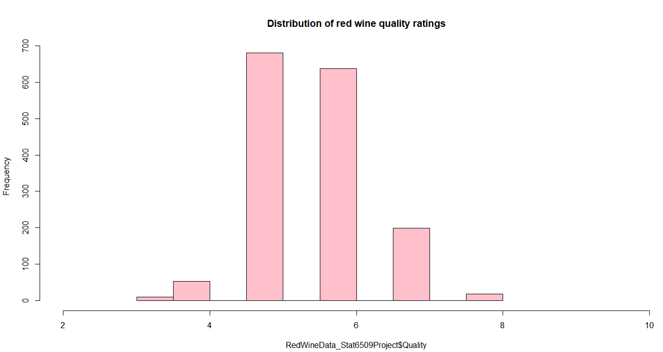
Exploratory Analysis
The majority of wine quality observations are graded between 5 and 6 .

Slide 6
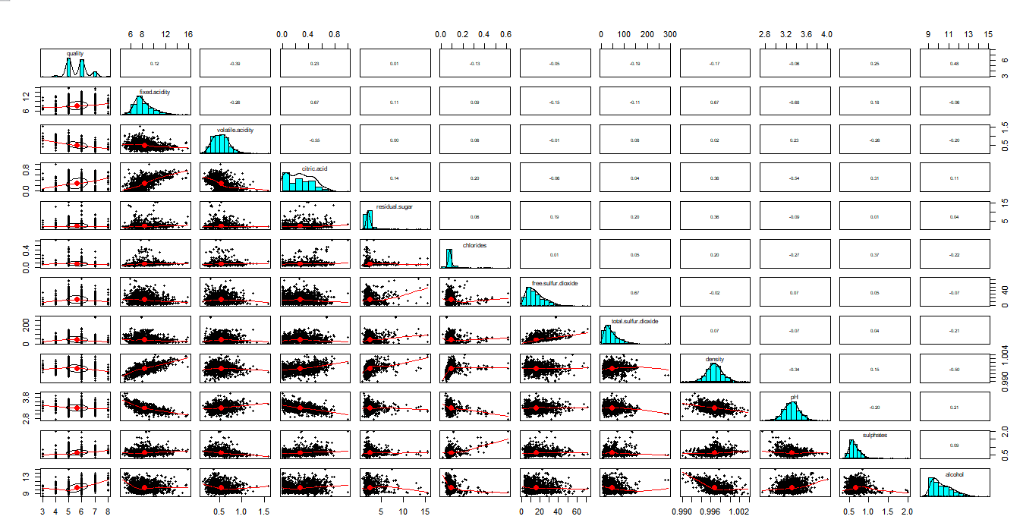
Volatile acid - 0.39
Alcohol 0.48
Citric acid 0.23
Sulphates 0.25

Slide 7
Model Selection
AIC (Variable Selection)
Model 1 (Additive Model)
Model 2 (Interaction Model)
Model 3 (Interaction Removing Insignificant Variables)
Compare Models and Pick Model
Notes:
Chi
AIC (Variable Selection) (additive and interactive model)
Model 1 and (Diagnostics) (additive model)
Same as Model 1 but Model 2 is Interactive Model
Check Model 3 (Remove insignificant variables)
Compare Models/Decision

Slide 8
AIC Variable Selection for Additive Model
Null model:
null=lm(Quality~1, data=RedWineData_Stat6509Project)
Full additive model:
full = lm(Quality~FixedAcidity+VolatileAcidity+CitricAcid+ResidualSugar+Chlorides+FreeSulfurDioxide+TotalSulfurDioxide+Denisty+pH+Sulphates+Alcohol, data=RedWineData_Stat6509Project)

Slide 9
AIC Variable Selection for Additive Model
Step: AIC=-1380.79
Quality ~ Alcohol + VolatileAcidity + Sulphates + TotalSulfurDioxide + Chlorides + pH + FreeSulfurDioxide

Slide 10
Model 1 (Additive model)
Quality ~ Alcohol + VolatileAcidity + Sulphates + TotalSulfurDioxide + Chlorides + pH + FreeSulfurDioxide
Coefficients are significant
Overall p-value < 0.05 → null hypothesis is rejected → conclude the linear relationship between Quality and predictors.
R-squared = 0.359 → the probability of the variance of the mean quality is explained by the model.
Coefficients | Estimate
Intercept | 4.4398856 ***
Alcohol | 0.2892090 ***
Volatile Acidity | -1.0117376 ***
Sulphates | 0.8803519 ***
TotalSulfurDioxide | -0.0035042 ***
Chlorides | -2.0165288 ***
pH | -0.4853000 ***
FreeSulfurDioxide | 0.0052080 *

Slide 11
AIC Variable Selection for Interactive Model
Null model:
null=lm(Quality~1, data=RedWineData_Stat6509Project)
Full interactive model:
full = lm(Quality~FixedAcidity*VolatileAcidity*CitricAcid*ResidualSugar*Chlorides*FreeSulfurDioxide*TotalSulfurDioxide*Denisty*pH*Sulphates*Alcohol, data=RedWineData_Stat6509Project)

Slide 12
AIC Variable Selection for Interactive Model
Step: AIC=-1453.22
Quality ~ Alcohol + VolatileAcidity + Sulphates + TotalSulfurDioxide +
Chlorides + pH + CitricAcid + FreeSulfurDioxide + Alcohol:Sulphates +
Sulphates:TotalSulfurDioxide + VolatileAcidity:TotalSulfurDioxide +
Sulphates:CitricAcid + TotalSulfurDioxide:CitricAcid + Chlorides:FreeSulfurDioxide

Slide 13
Model 2 (Interactive Model)
Quality ~ Alcohol + VolatileAcidity + Sulphates + TotalSulfurDioxide + Chlorides + pH + CitricAcid + FreeSulfurDioxide + Alcohol:Sulphates + Sulphates*TotalSulfurDioxide + VolatileAcidity*TotalSulfurDioxide + Sulphates*CitricAcid + TotalSulfurDioxide*CitricAcid + Chlorides*FreeSulfurDioxide
Coefficients | Estimate
Intercept | 6.576683***
Alcohol | 0.094360
Volatile Acidity | -1.560689***
Sulphates | -1.020599
TotalSulfurDioxide | -0.002625
Chlorides | -0.567264
pH | -0.671902***
CitricAcid | 0.026642
Coefficients | Estimate
FreeSulfurDioxide | 0.010273**
Alcohol:Sulphates | 0.305068**
Sulphates: TotalSulfurDioxide | -0.014091***
VolatileAcidity:TotalSulfurDioxide | 0.012032***
Sulphates:CitricAcid | -0.862744.
TotalSulfurDioxide:CitricAcid | 0.005328.
Chlorides:FreeSulfurDioxide | -0.051688
Some coefficients are not significant
Overall p-value < 0.05 → null hypothesis is rejected → conclude the linear relationship between Quality and predictors.
R-squared = 0.3929 → the probability of the variance of the mean quality is explained by the model.

Slide 14
Model 3 removing insignificant variables from model 2
Quality ~ Alcohol + VolatileAcidity + Sulphates + TotalSulfurDioxide + Chlorides + pH + CitricAcid + FreeSulfurDioxide + Alcohol*Sulphates + Sulphates*TotalSulfurDioxide + VolatileAcidity*TotalSulfurDioxide
Coefficients | Estimate
Intercept | 4.4398856***
Alcohol | 0.2892090
Volatile Acidity | -1.0117376***
Sulphates | 0.8803519
TotalSulfurDioxide | -0.0035042
Chlorides | -2.0165288***
pH | -0.4853000***
Citric Acid | -0.308594*
Coefficients | Estimate
FreeSulfurDioxide | 0.0052080*
Alcohol*Sulphates | 0.30242**
Sulphates*TotalSulfurDioxide | -0.014471***
VolatileAcidity*TotalSulfurDioxide | 0.009173***
Most of coefficients are significant
Overall p-value < 0.05 → null hypothesis is rejected → conclude the linear relationship between Quality and predictors.
R-squared = 0.3892 → the probability of the variance of the mean quality is explained by the model.

Slide 15
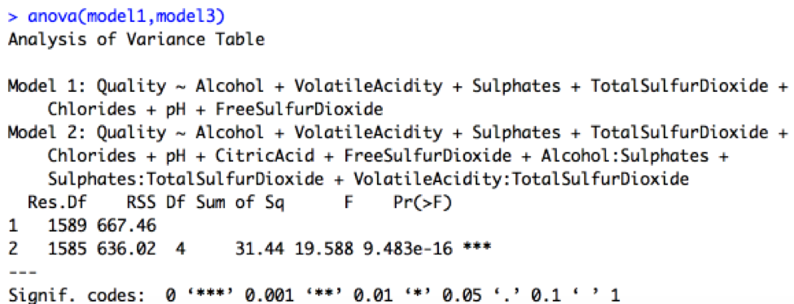
Comparing model 1 & model 3
→ Choose model 3 over model 1

Slide 16
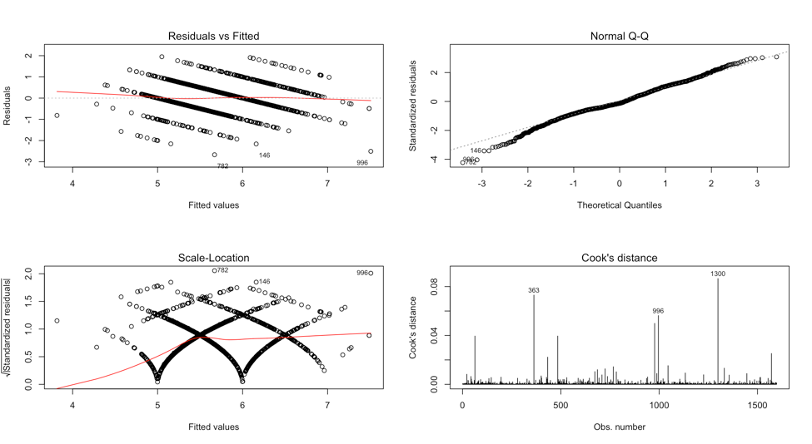
Model 3 - Diagnostics

Slide 17
Checking for Outliers
Checked for Outliers with Model 3
Using the Outlier Test, we found an outlier on row 782 with a Bonferonni p-value of .036355 ( < .05)
Found Influential Points for our Model 3
Using the Influence Plot command, we found 6 Influential Points. The two most influential of these points come from rows 363 and 1300.
Notes:
Simona
Check Outliers
Find Influential Points (Influential Plot)
End up with Model 3c removing highest influence outliers

Slide 18
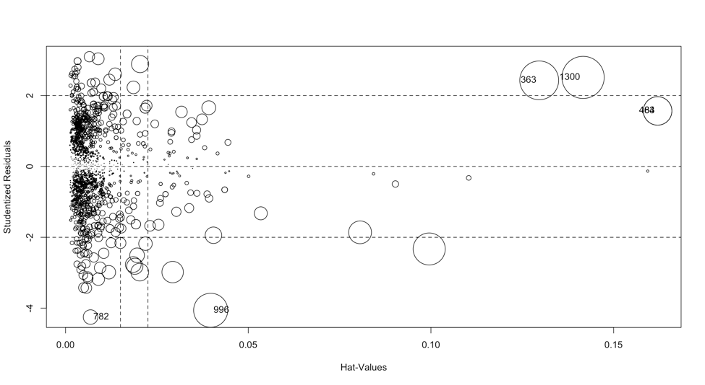
Improving model 3 - High leverage Outliers
Points 1300 and 363

Slide 19
Model 3c - Final Model
Removed 2 Influential Points to create Model 3C, our Final Model
Quality ~ Alcohol + VolatileAcidity + Sulphates + TotalSulfurDioxide + Chlorides + pH + CitricAcid + FreeSulfurDioxide + Alcohol*Sulphates + Sulphates*TotalSulfurDioxide + VolatileAcidity*TotalSulfurDioxide
Coefficients | Estimate
Intercept | 7.055998***
Alcohol | 0.053301
Volatile Acidity | -1.613920***
Sulphates | -1.899649.
Total Sulfur Dioxide | -0.003413
Chlorides | -1.565631***
Coefficients | Estimate
pH | -0.597094***
Citric Acid | -0.316153**
Free Sulfur Dioxide | 0.006185**
Alcohol*Sulphates | 0.353586***
Sulphates*Total Sulfur Dioxide | -0.012229***
Volatile Acidity* Total Sulfur Dioxide | 0.013215***
Most of coefficients are significant
Overall p-value < 0.05 → null hypothesis is rejected → conclude the linear relationship between Quality and predictors.
R-squared = 0.3926 → the probability of the variance of the mean quality is explained by the model.
(R-squared was improved)

Slide 20
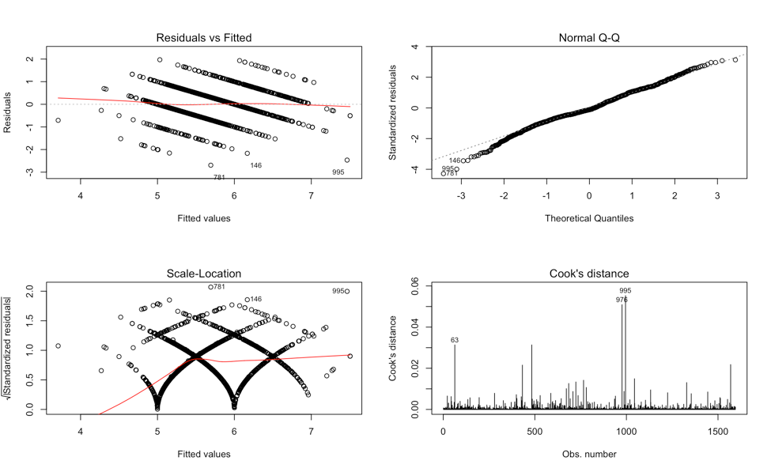
Final Model - Diagnostics Plot

Slide 21
Final Model - Formal Tests
Constant Variance
Constant Variance P-value ran with ncvTest command: 0.0001224764
Normality
Shapiro Wilks P-value: 1.121e-08
Notes:
Simona and Chi
Residual Plot (Constant Variance) and Formal Test
Normality QQ plot and Formal Test

Slide 22
Conclusion
Overall, our group is pleased with our Final Model.
Even though we believe we have a good model, there are a few options we would try to do to improve our model in the future.
Increase R²
One of the best ways to do this is to include other predictors in a future model that were not in our data set.
Potential Predictors that may have a relationship with the quality of red wine: location of vineyards, type of grape, other ingredients.
Have a better way to measure Quality (Y Variable)
Increase Normality and Constant Variance
Notes:
Simona and Chi
Where Grapes are Grown and other predictors?
How to improve model in future
Talk about good and bad of our model (maybe find a better way to have a y variable)
Overall thoughts

Slide 23
R Code
#Rename variables
colnames(RedWineData_Stat6509Project)=c("FixedAcidity", "VolatileAcidity", "CitricAcid", "ResidualSugar", "Chlorides", "FreeSulfurDioxide", "TotalSulfurDioxide", "Denisty", "pH", "Sulphates", "Alcohol", "Quality")
#histogram for the distribution of quality ratings
hist(RedWineData_Stat6509Project$Quality,main="Distribution of red wine quality ratings",xlim = c(2,10),
,col = c("pink"))
#more informative scatterplot matrix
install.packages("psych")
library(psych)
pairs.panels(RedWineData_Stat6509Project[c("Quality","FixedAcidity", "VolatileAcidity", "CitricAcid", "ResidualSugar", "Chlorides", "FreeSulfurDioxide", "TotalSulfurDioxide", "Denisty", "pH", "Sulphates", "Alcohol")])
# Run AIC to choose variables for model
null=lm(Quality~1, data=RedWineData_Stat6509Project)
summary(null)
#Additive models
full = lm(Quality~FixedAcidity+VolatileAcidity+CitricAcid+ResidualSugar+Chlorides+FreeSulfurDioxide+TotalSulfurDioxide+Denisty+pH+Sulphates+Alcohol, data=RedWineData_Stat6509Project)
summary(full)
step(null, scope=list(lower=null, upper=full),
direction="forward")
model1=lm(formula = Quality ~ Alcohol + VolatileAcidity + Sulphates +
TotalSulfurDioxide + Chlorides + pH + FreeSulfurDioxide,
data = RedWineData_Stat6509Project)
summary(model1)
#Diagnostics with Model 1
par(mfrow=c(2,2))
plot(model1, which=1:4)
#With Interactions
full2 = lm(Quality~FixedAcidity*VolatileAcidity*CitricAcid*ResidualSugar*Chlorides*FreeSulfurDioxide*TotalSulfurDioxide*Denisty*pH*Sulphates*Alcohol, data=RedWineData_Stat6509Project)
summary(full2)
step(null, scope=list(lower=null, upper=full2),
direction="forward")

Slide 24
R Code
model2=lm(formula = Quality ~ Alcohol + VolatileAcidity + Sulphates +
TotalSulfurDioxide + Chlorides + pH + CitricAcid + FreeSulfurDioxide +
Alcohol:Sulphates + Sulphates:TotalSulfurDioxide + VolatileAcidity:TotalSulfurDioxide +
Sulphates:CitricAcid + TotalSulfurDioxide:CitricAcid + Chlorides:FreeSulfurDioxide,
data = RedWineData_Stat6509Project)
summary(model2)
#Diagnostics with Model 2
par(mfrow=c(2,2))
plot(model2, which=1:4)
#Check if interaction needed
anova(model1,model2)
#model 3 interaction removing insignificant variables
model3=lm(formula = Quality ~ Alcohol + VolatileAcidity + Sulphates +
TotalSulfurDioxide + Chlorides + pH + CitricAcid + FreeSulfurDioxide +
Alcohol:Sulphates + Sulphates:TotalSulfurDioxide + VolatileAcidity:TotalSulfurDioxide,
data = RedWineData_Stat6509Project)
summary(model3)
#Compare models
anova(model1,model3)
#Choose model 3 over model 1
#Diagnostics for model 3
par(mfrow=c(2,2))
plot(model3, which=1:4)
#Improve the model 3
#Check outliers
install.packages("car")
library(car)
par(mfrow=c(1,1))
qqPlot(model3, id.n=2)
outlierTest(model3)
#Outliers with high leverage
influencePlot(model3)

Slide 25
R Code
#removing highest leverage outliers FINAL MODEL
newdata1 <- RedWineData_Stat6509Project[c(-363,-1300),]
model3c = lm(formula = Quality ~ Alcohol + VolatileAcidity + Sulphates +
TotalSulfurDioxide + Chlorides + pH + CitricAcid + FreeSulfurDioxide +
Alcohol:Sulphates + Sulphates:TotalSulfurDioxide + VolatileAcidity:TotalSulfurDioxide,
data = newdata1)
summary(model3c)
#Check outlier distribution with the final model
influencePlot(model3c)
#Diagnostics for model 3
par(mfrow=c(2,2))
plot(model3c, which=1:4)
#Diagnostics Model 3c
par(mfrow=c(2,2))
plot(model3c, which=1:4)
shapiro.test(model3c$residuals)
ncvTest(model3c)

